Slide 1
Kubernetes Security with Calico and Open Policy Agent
Wes MacDonald @wesmacdonald &
Eric Leonard @erleonard

Slide 2
Network policy
All Pods are non-isolated by default
Flat network. All pods can talk to other pods
Accept traffic from anyone
Multi stage/zone project this could expose security risks
3 tier webapp.
Front end could technically talk directly to DB tier

Slide 3
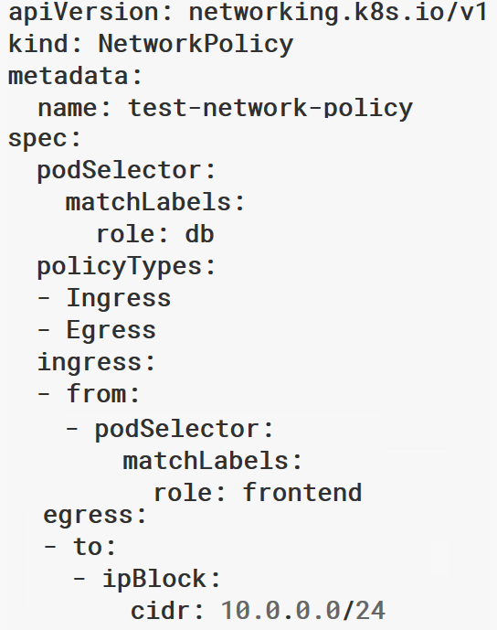
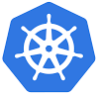
Azure Kubernetes Network Policies
kubectl apply –f policy.yaml
Provides micro-segmentation for containers – like NSGs for VMs
Label-based selection of Pods
Policy resource yaml file specifies Ingress and Egress policies
Policies defined for a label
Works in conjunction with Azure CNI
Supports Linux hosts
Supported in aks-engine
Set networkPolicy setting to azure in cluster definition file
Supported on AKS in Preview
Kubernetes Master
Azure Policy Manager
Azure Policy Manager
Label: Test
Label: Prod
Kubernetes Cluster

Slide 4
Network policy
apiVersion: networking.k8s.io/v1
kind: NetworkPolicy
metadata:
name: test-network-policy
namespace: default
spec:
podSelector:
matchLabels:
role: db
policyTypes:
- Ingress
- Egress
ingress:
- from:
- ipBlock:
cidr: 172.17.0.0/16
except:
- 172.17.1.0/24
- namespaceSelector:
matchLabels:
project: myproject
- podSelector:
matchLabels:
role: frontend
ports:
- protocol: TCP
port: 6379
egress:
- to:
- ipBlock:
cidr: 10.0.0.0/24
ports:
- protocol: TCP
port: 5978
Pod Selector
PolicyTypes
Ingress, egress
Ingress
namespaceSelector
podSelector
ipBlock

Slide 5
Network policy
Recommend to create default policies that apply to all pods
Default deny all ingress traffic
Default deny all egress traffic.
Allow Specific Traffic (Ingress & Egress)

Slide 6
Calico Global Network Policy
apiVersion: projectcalico.org/v3
kind: GlobalNetworkPolicy
metadata:
name: allow-tcp-6379
spec:
selector: role == 'database'
types:
- Ingress
- Egress
ingress:
- action: Allow
protocol: TCP
source:
selector: role == 'frontend'
destination:
ports:
- 6379
egress:
- action: Allow

Slide 7
Calico Global Network Set
apiVersion: projectcalico.org/v3
kind: GlobalNetworkSet
metadata:
name: a-name-for-the-set
labels:
role: external-database
spec:
nets:
- 198.51.100.0/28
- 203.0.113.0/24

Slide 8
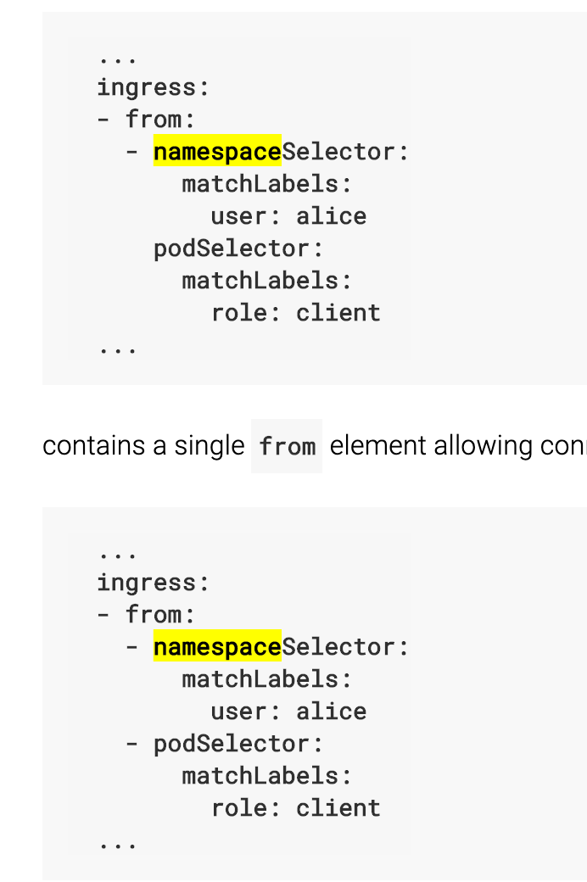
<- Single Rule where two conditions must be met
<- two conditions either/or must be met

Slide 9
When to use Azure NSG vs. Kubernetes Network policy
Azure Network Security Groups
Use it to filter North-South traffic, that is, traffic entering and leaving your cluster subnet
Kubernetes Network Policies
Use it to filter East-West traffic, that is, traffic between pods in your cluster

Slide 10
Network Policy Demo
Fruit Categorization App
Web Frontend
ML Backend for image recognition
Signal R as a managed websocket service between FE/BE
Default allow
Create a policy (deny all by default)
Open a policy to communicate between FE/BE services

Slide 11
Open Policy Agent

Slide 12
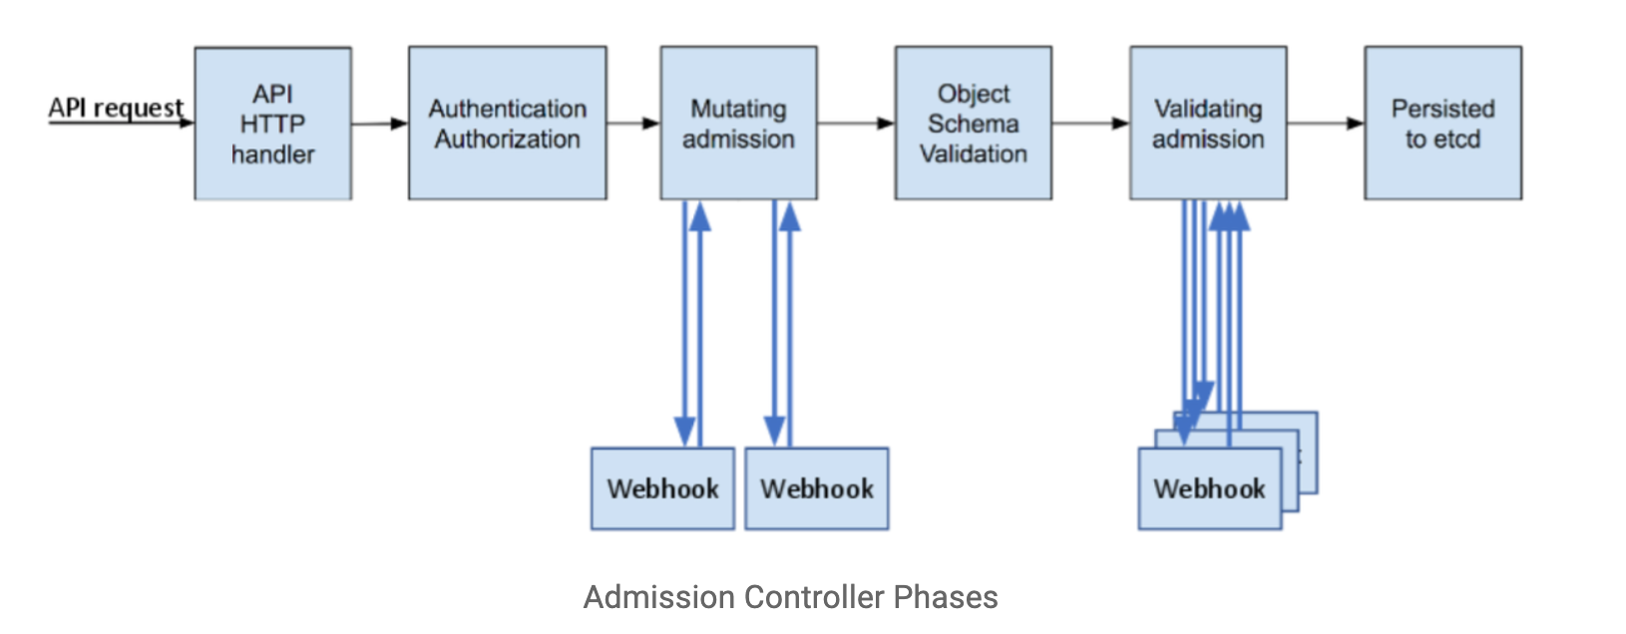

Slide 13
Dynamic Admission Control
Validating Webhook
Allows you to intercept and validate requests
Can be run in parallel, as they don’t mutate objects
Example use case: restricting resource creation
Mutating Webhook
Executes the mutation by sending requests to webhook server
Matching webhooks are called in serial
Example use case: injecting side cars
Policy Enforcement
Admission Control is policy based on Kubernetes objects.
Network Policy and PodSecurity Policy focus on data plane policy
RBAC is policy enforced on the user
Notes:
Talk more of what can Dynamic Admission controllers are and their use cases
; each one may modify the object if it desires

Slide 14
That’s awesome! But…
Notes:
So yes dynamic controllers are awesome, but they create a lot of custom code that has to be mainted and configured in Kubernetes

Slide 15
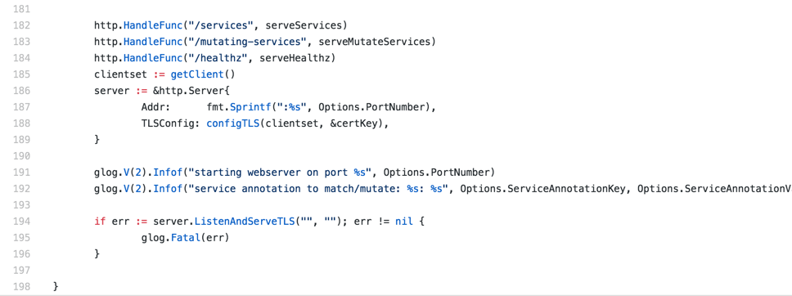
Sample Admission Webhook

Slide 16
Open Policy Agent
CNCF Hosted Sandbox Project
General purpose policy engine
Can be used across the stack
Declarative policy language (Rego)
Image: openpolicyagent.org
Notes:
Overview key features of the Open Policy Agent

Slide 17
Request
Service refers to:
Kubernetes API
Custom API
SSH Daemon
Terraform
Authorization APi
Service
Enforcement
Policy
Query
Policy
Decision
OPA
Input can be any JSON value:
"kind": "Service",
"metadata": {
"annotations": {
department: dev
}
Output can be any JSON value:
”true
”request annotated” “ “annotations": {
costCenter: 8000
}
Policy
(Rego)
Data
(JSON)
Diagram rewritten from: www.openpolicyagent.org
Notes:
More detail in how Open Policy agent makes enforcement decisions

Slide 18
Example Rego Policy
Rego is a policy language and not a programing language, so don’t think about sockets, methods, binary trees, etc.
Think about two things: Logic and Data
Rego logic is all queries. A query finds values for variables that make boolean conditions true.
You write logic to search and combine JSON/YAML data from different sources.
deny[{
"id": "conditional-annotation",
"resource": {"kind": kind, "namespace": namespace, "name": name},
"resolution": {"patches": p, "message" : "conditional annotation"}, }] {
matches[[kind, namespace, name, matched_object]] matched_object.metadata.annotations[”Mr-T"]
p = [{"op": "add", "path": "/metadata/annotations/cost-center", "value": ”A-Team"}] }
Notes:
Outline rego and a sample policy

Slide 19
Who manages all this policy?
Developer
Deploys Apps
Ice Kube
OPA Policy
Audits Platform
Platform Operator
Creates And Maintains
The Governor
Acid Burn

Slide 20
Kubernetes Policy Controller
Kubernetes Policy Controller
Moving to OPA org, as a standard Kubernetes Policy Controller
Authorization module makes it possible to implement a blacklist in front of RBAC
Provides auditing features
Deployment consist of three containers: OPA, kube-mgmt., and Controller
Examples:
Whitelist / blacklist registries.
Not allow conflicting hosts for ingresses.
Label objects based on a user from a department.
Block kubectl exec <pod>
Notes:
General Overview of of the Kubernetes Policy Management Controller

Slide 21
Demos
apiVersion: v1
Kind: Service
Name: jetson-lb
Spec:
type: LoadBalancer
….
request
evaluation
Mutate
Load Balancer
apiVersion: v1
Kind: Ingress
Name: elroy-ingress
Spec:
host: elroy.tugboatlabs
request
evaluation
Deny Conflicting
Ingress Host Names
kubectl exec api-server
request
evaluation
Restrict Access To CRDs

Slide 22
The Good, The Bad, and Gotchas
Good
OPA approach allows you to decouple policy from your applications
General purpose, so can be used outside of Kubernetes context.
Bad
There can be a learning curve to Rego.
Can cause latency, but’s negligible for most apps. (more of a consideration)
Gotchas
Mutating objects need to be handled with care. They can cause unexpected behavior to what the end-user expects.
Notes:
Talk about takeaways and what attendees learned and renforce how OPA\Policy controller solves the Problem from first few slides

Slide 23
Takeaways
Focus on security is a must in any Kubernetes deployment.
Help educate Security Teams on how to extend Kubernetes to integrate custom policies.
Treat the Kubernetes cluster as immutable, just like you do with applications.
Multiple ways to accomplish policy
Build all your own logic and utilize dynamic admission control
Utilize Open Policy Agent to simplify deployment and logic for rule sets.
Notes:
Talk about takeaways and what attendees learned and renforce how OPA\Policy controller solves the Problem from first few slides

Slide 24
Example Policies
https://github.com/open-policy-agent/contrib

